Slide 1
Further
Spend every day wisely

Slide 2
Medical and Dependent Care FSAs
2 | Proprietary + Confidential

Slide 3
Your Flexible Spending Account (FSA)
Making it easier to manage medical and dependent care costs while you work
An expense reimbursement account that works with your health plan, paying for qualified medical and dependent care costs, tax-free
Your contributions are pretax and deducted from your paycheck to fund the account
Save money on these costs¹
¹ Depends on your tax filing status. Please consult your tax advisor with questions.

Slide 4
How your FSA works
You Estimate next year’s eligible medical and dependent care costs
Equal Portions are deposited from your paycheck into the account
Funds Available For a medical FSA, money is available day one. For a dependent care FSA, money is available when deposited
A Spouse in another plan may also open a medical FSA or a dependent care FSA
2021:
Medical FSA: $2,750 contribution limit
Dependent care FSA: $5,000 contribution limit ($2,500 if Married and Filing Separately)
Medical FSA
Use a convenient FSA debit card to pay providers for eligible medical expenses
Dependent Care FSA
Submit claims for reimbursement online or by faxing
An FSA is typically a “use it or lose it” account¹
¹ Depending on how your employer sets up the account, money may be forfeited at end of the plan year or grace period.

Slide 5
You can use your Medical FSA to pay for:
These you can’t pay for:
NEW! Over-the-counter supplies, medications, and some feminine hygiene products
Expenses for you, your spouse, and any health plan dependent
Medical expenses not covered by your health plan, including:
Out-of-pocket medical expenses
Copayments, coinsurance
Prescription drugs
Dental and vision care expenses
If you have an HSA, your FSA will be limited to vision and dental expenses until your health plan deductible has been met
Costs that aren’t considered qualified medical expenses as defined by the IRS
Health insurance premiums
Always save your receipts to ensure proper validation of expenses, as required by the IRS.

Slide 6
You can use your Dependent Care FSA to pay for:
These you can’t pay for:
Licensed day care, nursery, or preschool
Summer day camp
Before and after school care
Eldercare
Education/tuition
Field trip expenses
Overnight camp
Always save your receipts to ensure proper validation of expenses, as required by the IRS.

Slide 7
Meet the Jacksons Two-parent family with four school-age children
 | Without an FSA | With an FSA
Estimated taxes¹ | $26,400 | $24,540
Health care expense | $1,200 | $1,200
FSA account | $0 | $1,200
DCAP account | $0 | $5,000
Combined annual salary: | $88,000
FSA & DCAP pretax contribution: | $6,200
Net taxable income: | $81,800
$1,860 Tax Savings
At year’s end, the Jacksons have not only saved $1,860 in taxes, but they have used those savings to cover all their health care and childcare expenses.
¹Assumes the Jacksons pay 30% of their income in federal, State and social security taxes. Actual tax savings will depend on your contributions, applicable State tax rates and your personal tax situation. Please consult your tax adviser for details. The Jacksons’ story is a hypothetical example for purposes of illustration only.
7 | Proprietary + Confidential

Slide 8
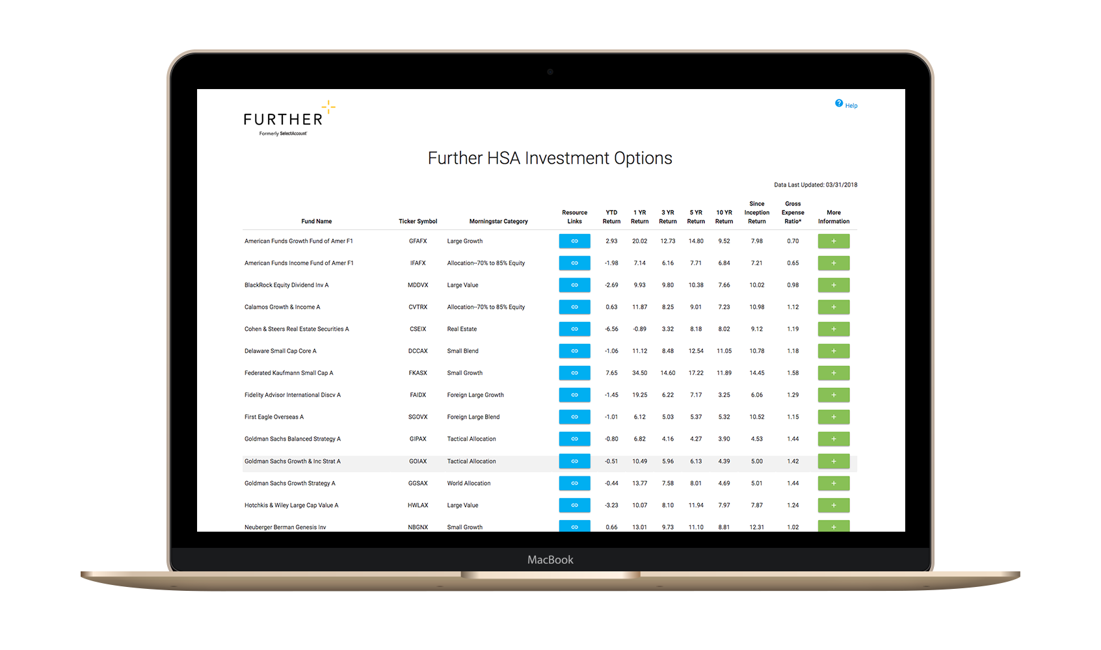
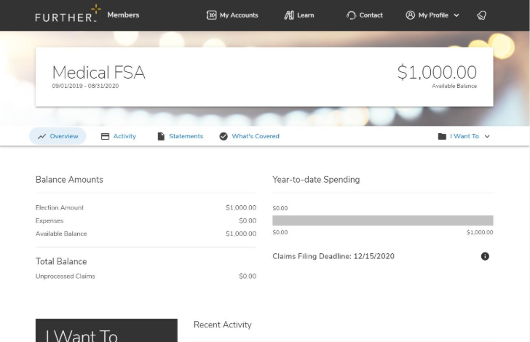
After you’re enrolled
Receive your Spending Account I.D. and Visa® debit card (for medical FSA only) by mail
Register on hellofurther.com
Download mobile app
Pay providers for medical expenses with your Visa® debit card or submit claims for reimbursement for dependent care expenses
View account activity and check balances
Download forms and upload receipts
Request additional Visa® debit cards
Notes:
To be used for FSA and HSA PowerPoints

Slide 9
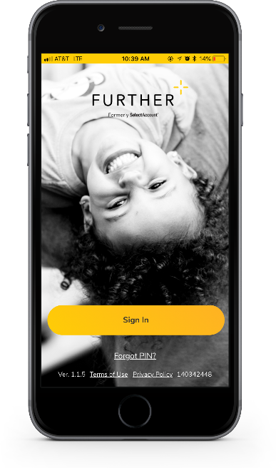
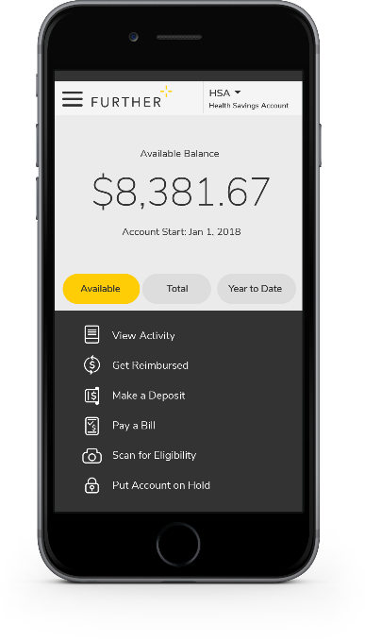
Mobile App
Easy to use tool that features:
Fingerprint and facial ID unlock
Snap and save document photos
Barcode scanner to check eligibility
Mobile access to all primary actions
View activity
Pay bills
Make deposits
Get reimbursed
Text options for account activities

Slide 10
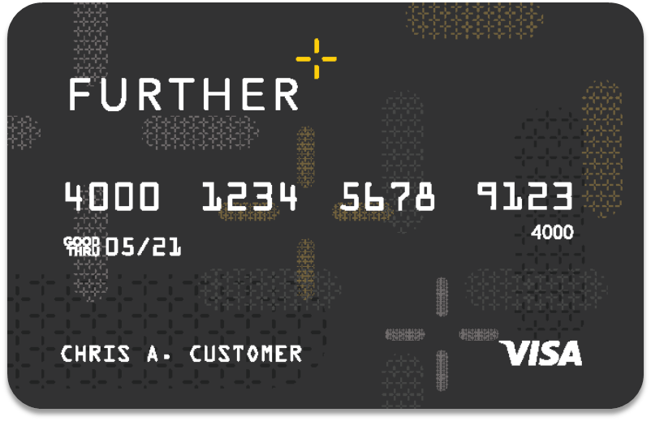
Further debit card
Use for medical FSA purchases (not available for use with dependent care purchases)
A convenient way to pay for qualified purchases from your spending account(s)
Can be added to your digital wallet¹
Can order additional cards for spouse or dependent free of cost
Accepted anywhere VISA® is accepted
The debit card will come in a plain envelope – do not throw it away.
¹Digital payments not available on all accounts.

Slide 11
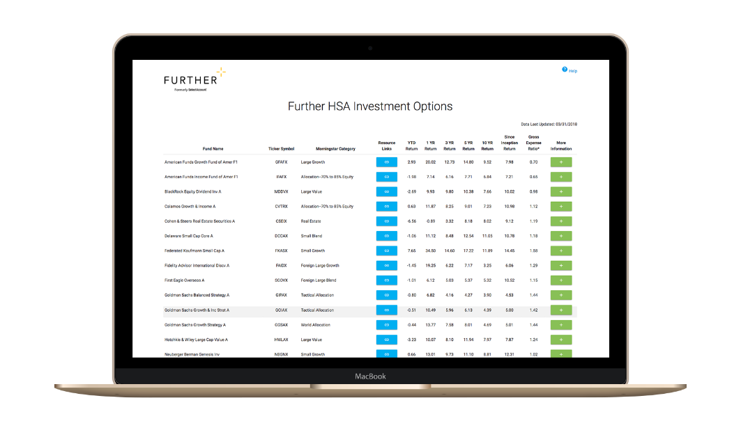
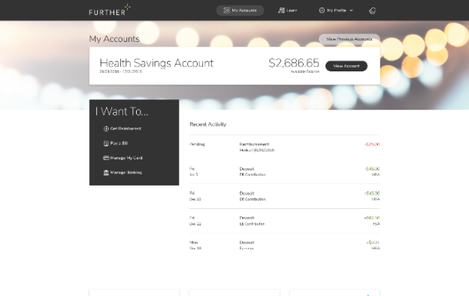
Learning Center
The Learning Center offers a robust array of articles, tools, and resources including:
Savings calculators, videos and popular forms
Guidance to help compare products
Employer walkthrough of open-enrollment communication
Tips for submitting claims
Help using and managing your account
Tax implication information
How to get reimbursed
FAQs
Designed to help you understand and maximize your health savings accounts

Slide 12
Let’s get started Our expert service team is ready to help.
800-859-2144
M-F 7 AM - 8 pm CST
hellofurther.com
Notes:
Adjust times to the appropriate time zone in which you are presenting

