Slide 1
Further
Spend every day wisely

Slide 2
Medical FSA
2 | Proprietary + Confidential

Slide 3
Your Medical Flexible Spending Account (FSA)
An expense account that works with your health plan
Pay for qualified medical costs, tax-free
Set aside a portion of your payroll pretax
Save money on these costs¹
¹ Depends on your tax filing status. Please consult your tax advisor with questions.

Slide 4
How your Medical FSA works
You Estimate next year’s out-of-pocket costs
Equal Portions are deposited from your paycheck into the account
Total amount is available day one
A Spouse in another plan may also open an FSA
Use a
A Medical FSA is a “use it or lose it” account¹
2021:
$2,750 contribution limit
convenient FSA debit card to pay providers for eligible expenses
¹ Depending on how your employer sets up the account, money may be forfeited at end of the plan year or grace period.

Slide 5
You can use your Medical FSA to pay for:
These you can’t pay for:
NEW! Over-the-counter supplies, medications, and some feminine hygiene products
Expenses for you, your spouse, and any health plan dependent
Medical expenses not covered by your health plan, including:
Out-of-pocket medical expenses
Copayments, coinsurance
Prescription drugs
Dental and vision care expenses
If you have an HSA, your FSA will be limited to vision and dental expenses until your health plan deductible has been met
Costs that aren’t considered qualified medical expenses as defined by the IRS
Health insurance premiums
Always save your receipts to ensure proper validation of expenses, as required by the IRS.

Slide 6
Combine FSA
Pairing with an HSA
If paired with an HSA, the FSA will be limited to permitted benefits such as vision and dental care benefits until the health plan deductible is met.
Pairing with an HRA
Pairing an FSA with an HSA, HRA, or VEBA increases the spending and savings power for members
If paired with an HRA allowing all 213(d) expenses to be reimbursed, eligible expenses will first be reimbursed from the Medical FSA until the account has been exhausted.
Pairing with a VEBA
If paired with a VEBA, eligible expenses will be reimbursed from the Medical FSA until the account has been exhausted. Only then will eligible expenses be reimbursed from the VEBA account.
.

Slide 7
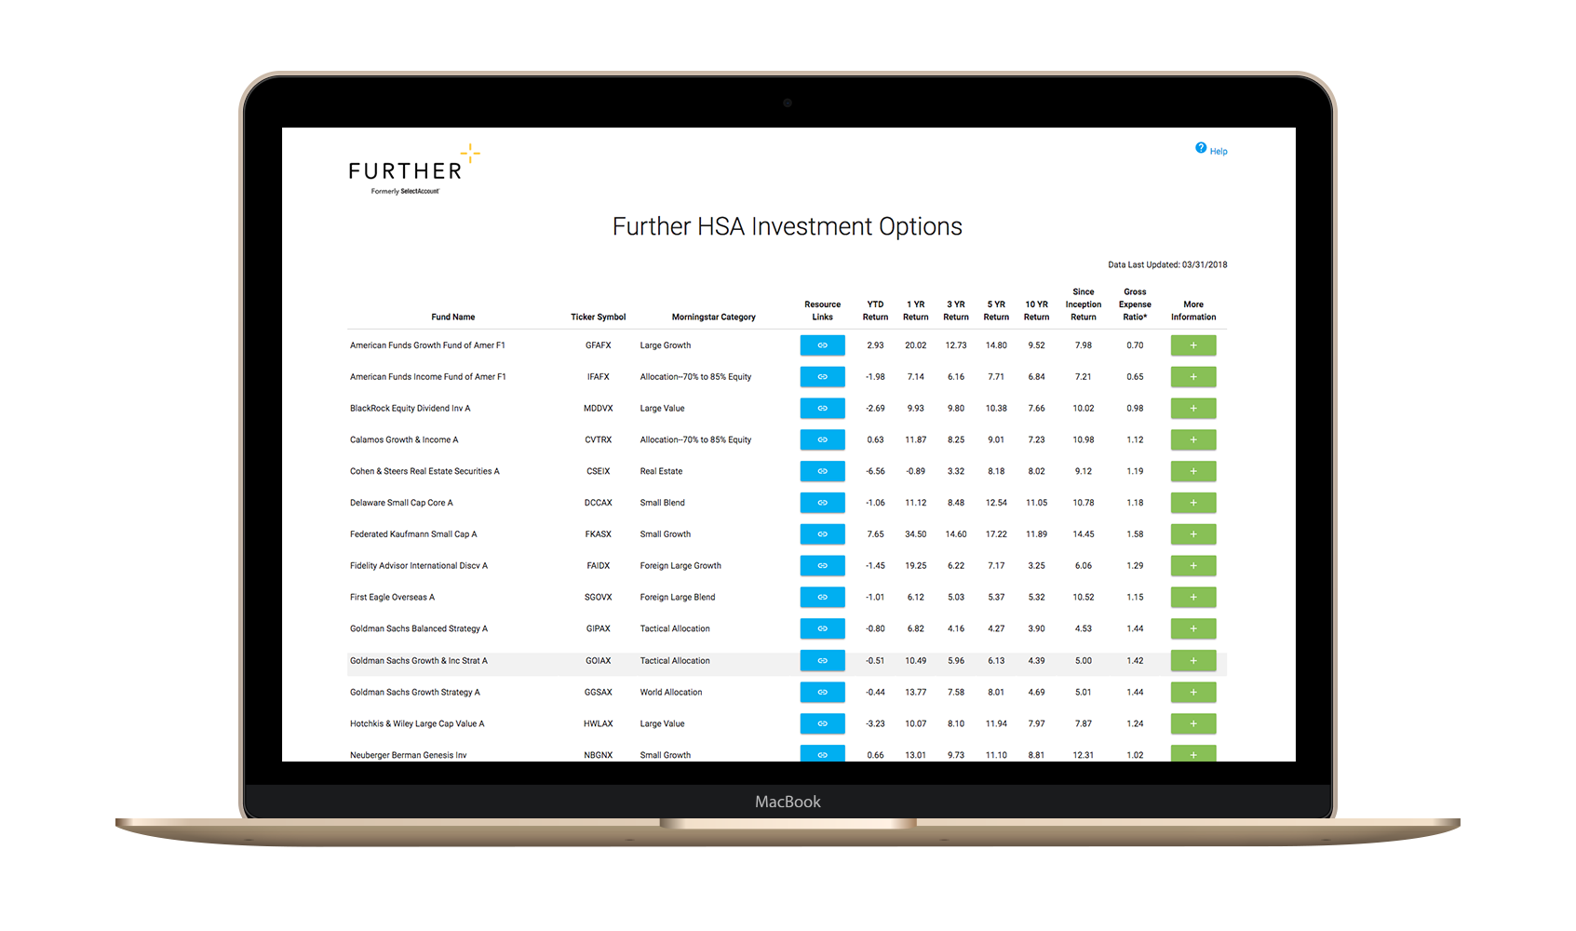
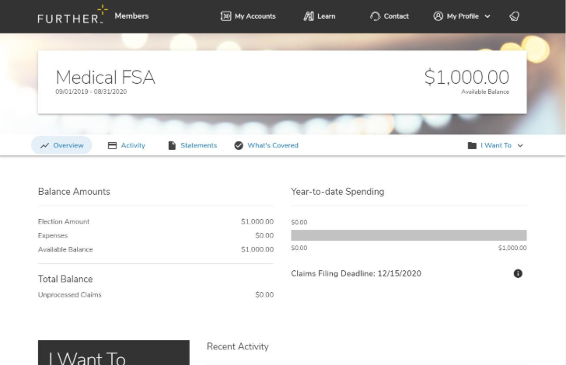
After you’re enrolled
Receive your Spending Account I.D. and Visa® debit card by mail
Register on hellofurther.com
Download mobile app
Pay providers with your Visa® debit card or submit claims for reimbursement
View account activity and check balances
Download forms and upload receipts
View and manage investments over $1,000
Request additional Visa® debit cards
Notes:
To be used for FSA and HSA PowerPoints

Slide 8
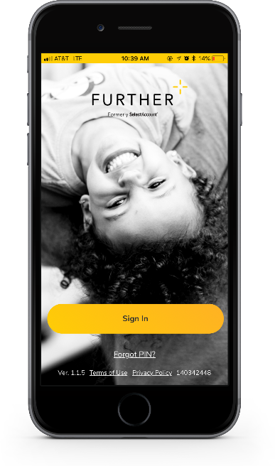
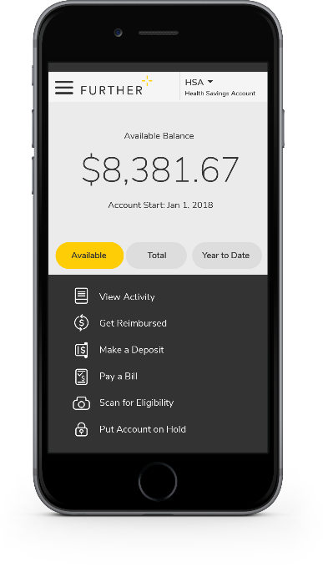
Mobile App
Easy to use tool that features:
Fingerprint and facial ID unlock
Snap and save document photos
Barcode scanner to check eligibility
Mobile access to all primary actions
View activity
Pay bills
Make deposits
Get reimbursed
Text options for account activities

Slide 9
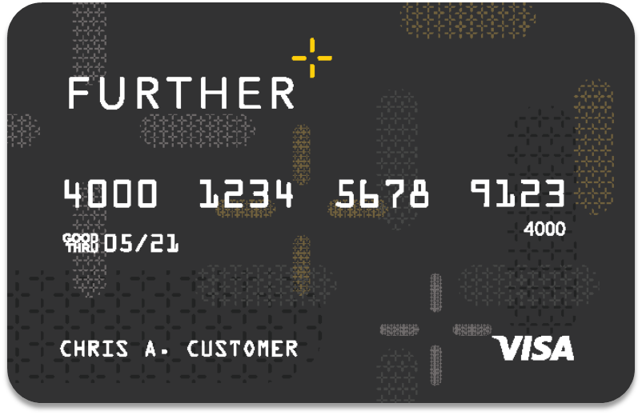
Further debit card
Can use for FSA purchases
A convenient way to pay for qualified purchases from your spending account(s)
Can be added to your digital wallet¹
Can order additional cards for spouse or dependent free of cost
Accepted anywhere VISA® is accepted
The debit card will come in a plain envelope – do not throw it away.
¹Digital payments not available on all accounts.

Slide 10
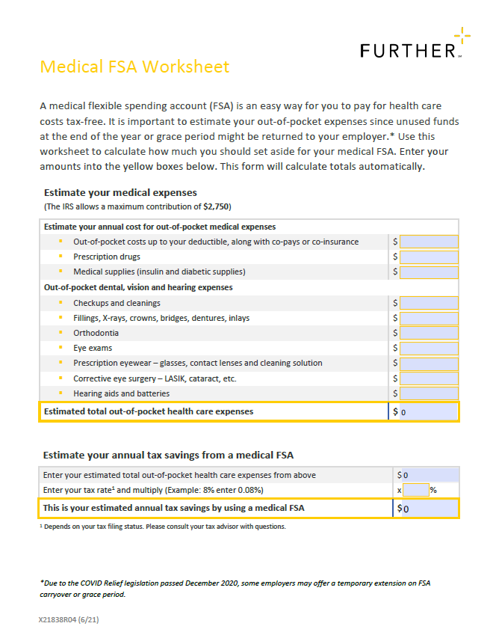
Interactive Worksheet
Easy-to-use, interactive worksheet to help you plan and budget
Simple tools that make decision-making easier
Notes:
For 101 Master OE Deck

Slide 11
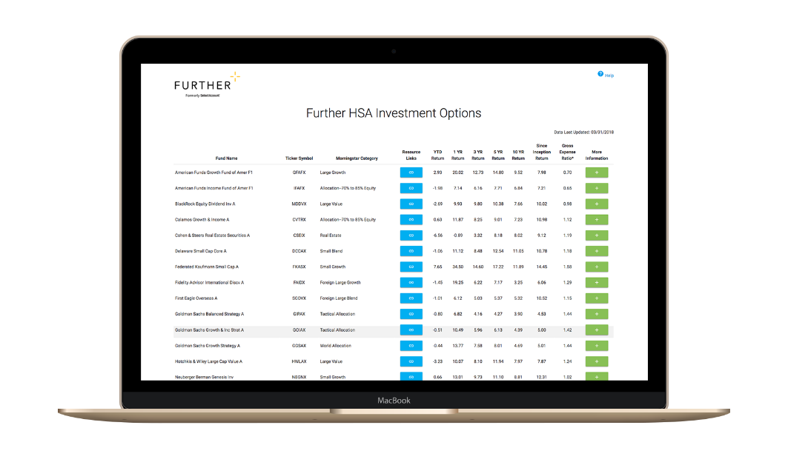
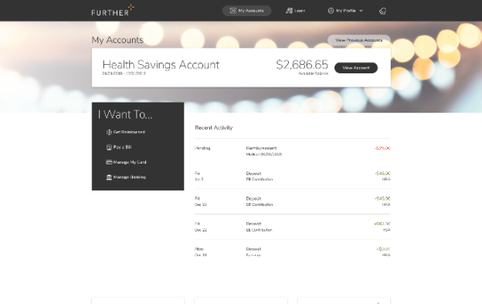
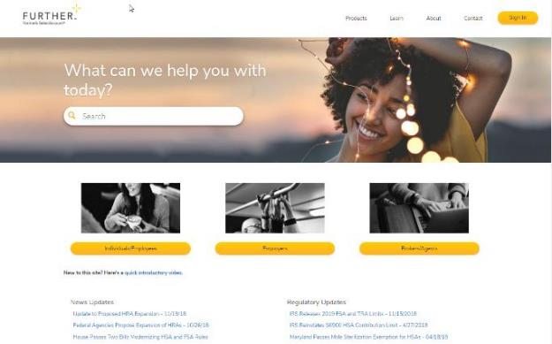
Learning Center
The Learning Center offers a robust array of articles, tools, and resources including:
Savings calculators, videos and popular forms
Guidance to help compare products
Employer walkthrough of open-enrollment communication
Tips for submitting claims
Help using and managing your account
Tax implication information
How to get reimbursed
FAQs
Designed to help you understand and maximize your health savings accounts

Slide 12
Let’s get started Our expert service team is ready to help.
800-859-2144
M-F 7 AM - 8 pm CST
hellofurther.com
Notes:
Adjust times to the appropriate time zone in which you are presenting

