Slide 1
Further
Spend every day wisely

Slide 2
Dependent Care FSA
2 | Proprietary + Confidential

Slide 3
Your Dependent Care Flexible Spending Account (FSA)
Making it easier to manage dependent care costs while you work
An expense reimbursement account for paying qualified dependent care costs, tax-free
Your contributions are pretax and deducted from your paycheck to fund the account
Save money on these costs¹
¹ ¹ Depends on your tax filing status. Please consult your tax advisor with questions.

Slide 4
How your Dependent Care
FSA Works
Estimate Next year’s eligible dependent care costs (estimate only what you think you will use*)
Equal Portions are deposited from your paycheck pre-tax into your account – your money is available when deposited
A Spouse
in another plan may also open a Dependent Care FSA
Submit Claims
for reimbursement – online or by faxing
2021: $5,000 maximum contribution limit ($2,500 if Married and Filing Separately)
4 | Proprietary + Confidential
* Depending on how your employer sets up the account, money may be forfeited at end of the plan year or grace period

Slide 5
You can use your Dependent Care FSA to pay for:
These you can’t pay for:
Licensed day care, nursery, or preschool
Summer day camp
Before and after school care
Eldercare
Education/tuition
Field trip expenses
Overnight camp
Always save your receipts to ensure proper validation of expenses, as required by the IRS.

Slide 6
Meet Susan Single parent, one child
Annual salary: | $58,000
Dependent Care FSA contribution | $5,000
Taxable income: | $53,000
 | Without Dependent Care FSA | With Dependent Care FSA
Dependent care contribution | $0 | $5,000
Estimated taxes¹ | $17,400 | $15,900
Dependent care expenses | $5,000 | $5,000
$1,500 Tax Savings
Estimated tax rate ¹ = 30%
¹Assumes Susan is subject to a 30% income tax rate. Actual tax savings will depend on your FSA contributions, applicable state tax rates and your personal tax situation. Please consult your tax adviser for details.
Susan’s story is a hypothetical example for purposes of illustration only.
6 | Proprietary + Confidential

Slide 7
Meet the Jacksons Two-parent family with four school-age children
 | Without an FSA | With an FSA
Estimated taxes¹ | $26,400 | $24,540
Health care expense | $1,200 | $1,200
FSA account | $0 | $1,200
DCAP account | $0 | $5,000
Combined annual salary: | $88,000
FSA & DCAP pretax contribution: | $6,200
Net taxable income: | $81,800
$1,860 Tax Savings
At year’s end, the Jacksons have not only saved $1,860 in taxes, but they have used those savings to cover all their health care and childcare expenses.
¹Assumes the Jacksons pay 30% of their income in federal, State and social security taxes. Actual tax savings will depend on your contributions, applicable State tax rates and your personal tax situation. Please consult your tax adviser for details. The Jacksons’ story is a hypothetical example for purposes of illustration only.
7 | Proprietary + Confidential

Slide 8
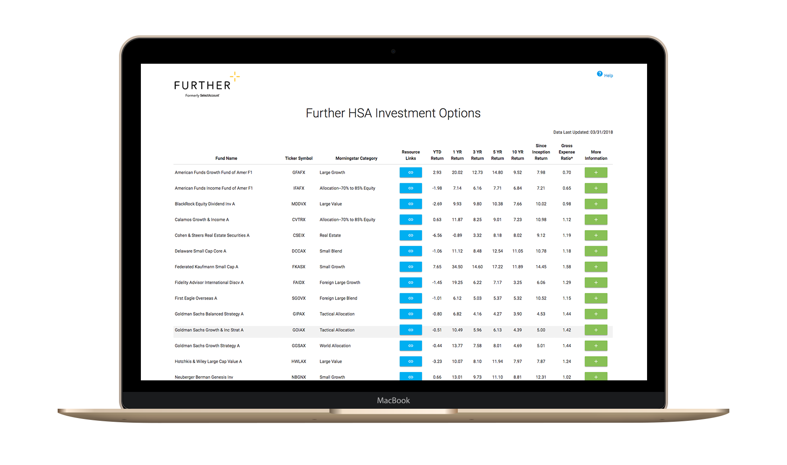
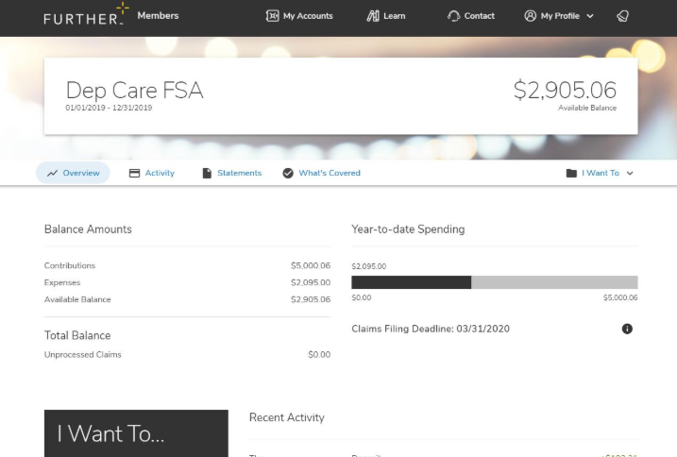
After you’re enrolled
Receive your Spending Account I.D. by mail
Register on hellofurther.com
Download mobile app
Submit claims for reimbursement
View account activity and check balances
Download forms and upload receipts
Notes:
To be used for DCAP

Slide 9
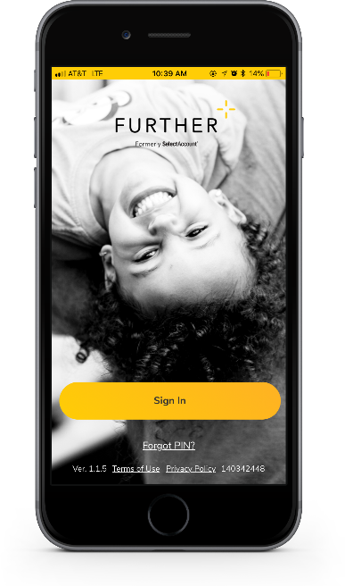
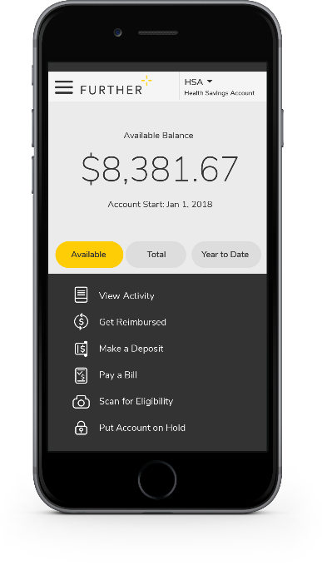
Mobile App
Easy to use tool that features:
Fingerprint and facial ID unlock
Snap and save document photos
Barcode scanner to check eligibility
Mobile access to all primary actions
View activity
Pay bills
Make deposits
Get reimbursed
Text options for account activities

Slide 10
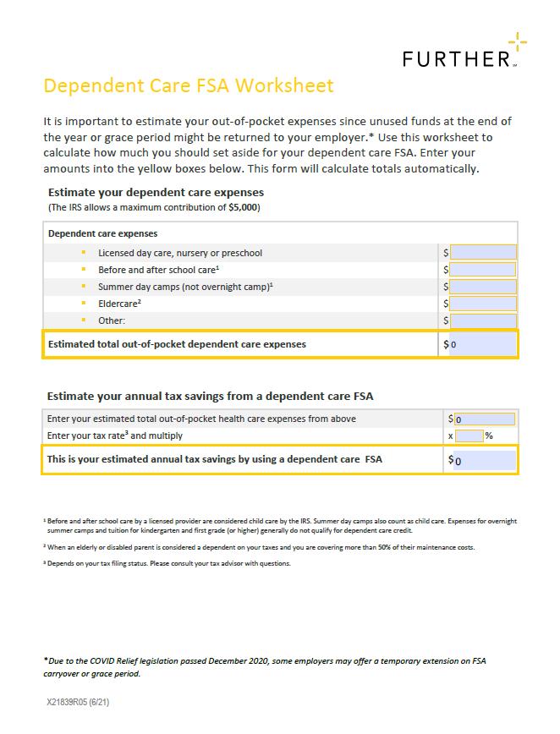
Interactive Worksheet
Easy-to-use, interactive worksheet to help you plan and budget
Simple tools that make decision-making easier
Notes:
For 101 Master OE Deck

Slide 11
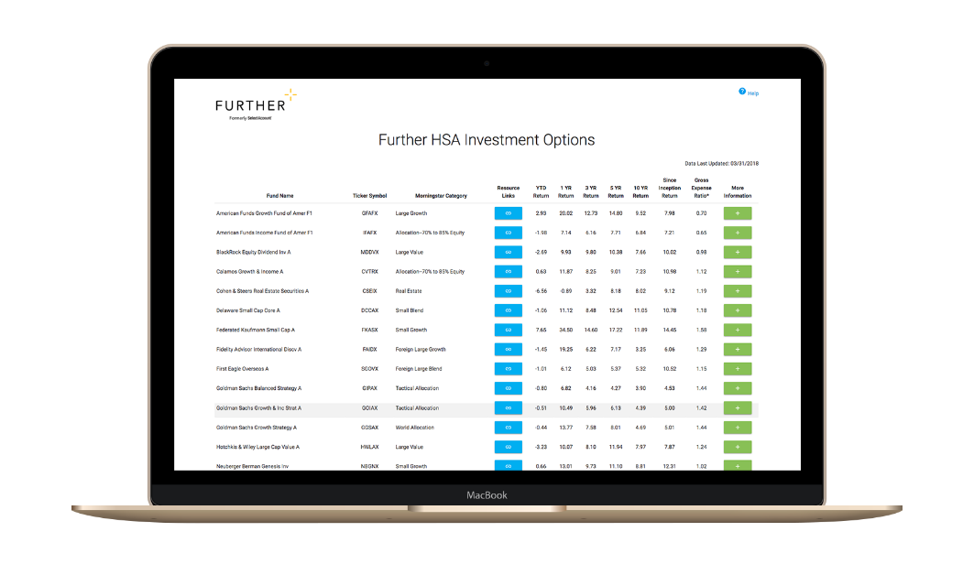
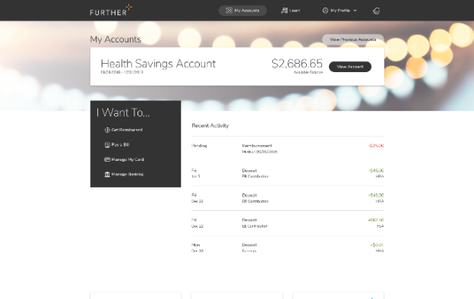
Learning Center
The Learning Center offers a robust array of articles, tools, and resources including:
Savings calculators, videos and popular forms
Guidance to help compare products
Employer walkthrough of open-enrollment communication
Tips for submitting claims
Help using and managing your account
Tax implication information
How to get reimbursed
FAQs
Designed to help you understand and maximize your health savings accounts

Slide 12
Let’s get started Our expert service team is ready to help.
800-859-2144
M-F 7 AM - 8 pm CST
hellofurther.com
Notes:
Adjust times to the appropriate time zone in which you are presenting

