Slide 1
Further
Spend every day wisely

Slide 2
TRA
2 | Proprietary + Confidential

Slide 3
Your Transportation Reimbursement Account (TRA)
Employers reduce payroll taxes for work-related transportation and/or parking expenses
Offered as part of your company’s benefit package, this tax-advantaged account reduces taxable income by allowing you to set aside pretax dollars to pay for eligible commuting costs
2021 Monthly Contribution Limits: Qualified Parking: $270 Transit and Vanpool: $270
3 | Proprietary + Confidential
3 | Proprietary + Confidential

Slide 4
You can use your TRA to pay for:
These you can’t pay for:
Bus, ferry, train, trolley tickets and passes
Parking expenses near work or location providing mass transit:
Meters
Garages
Lots
Secure bicycle storage
Vanpool fees (including UberPool and Lyft Line)
Tolls
Taxis
Gas and mileage
Airport parking fees
Always save your receipts to ensure proper validation of expenses, as required by the IRS.

Slide 5
How your TRA works
Enroll in the TRA benefit
Receive
a welcome letter in mail and email, with instructions on how to register your account on the member portal and access the TRA dashboard
Register & complete
an ”order” for preferred payment type – must be completed by the 4th of the month prior to the benefit month
For Example:
Order must be completed by February 4th to use in March
Can set up
recurring orders
Order Amount
will be deducted through pretax payroll
This timeline is dependent on the employer’s payroll schedule

Slide 6
TRA payment options
Pre-paid MasterCard®: A re-loadable debit card that can be used at designated transit agencies and parking facilities
Commuter Check Vouchers: These vouchers can be used at the transit authority or parking facility of choice
Fare Media: Transit passes or tickets sent directly to individuals’ homes
Smart Cards: Transit authority smart cards pre-loaded with pretax dollars
Parking Direct Pay: Payments sent on employees’ behalf directly to their parking providers on a monthly basis
Parking Cash Reimbursements: Employees can submit claims on the TRA dashboard to receive reimbursement by check or direct deposit
 | Public Transportation and Vanpools | Qualified Parking
Commuter Check Vouchers | X | X
Pre-paid MasterCard® | X | X
Fare Media | X
Smart Cards | X
Parking Direct Pay |  | X
Parking Cash Reimbursements |  | X
6 | Proprietary + Confidential

Slide 7
TRA dashboard overview
7 | Proprietary + Confidential

Slide 8
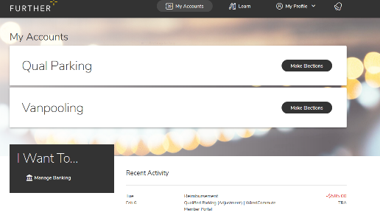
Account holder dashboard
Log into the Online Member Service Center: www.hellofurther.com
Click the MAKE ELECTIONS button next to Qual Parking or Vanpooling to access the TRA dashboard

Slide 9
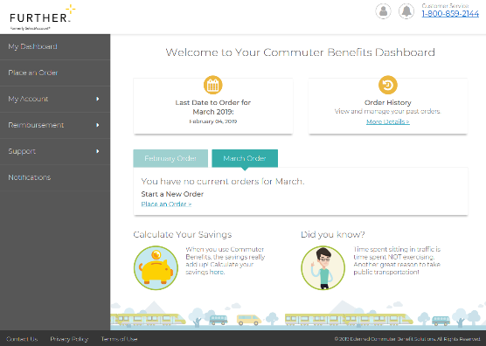
TRA dashboard
Check previously placed orders
You may edit or delete orders up until the 4th of the month for the following month

Slide 10
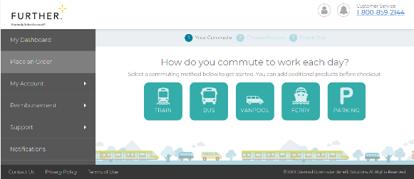
Placing an order
Orders must be placed by the 4th of the month for the following month
Example: You must order by February 4th for March transit and/or parking needs
Select ‘place an order’ and choose the service type you wish to order
Train, bus, vanpool, ferry, parking
Payment options will be generated based on your home and work zip codes
Choose payment option

Slide 11
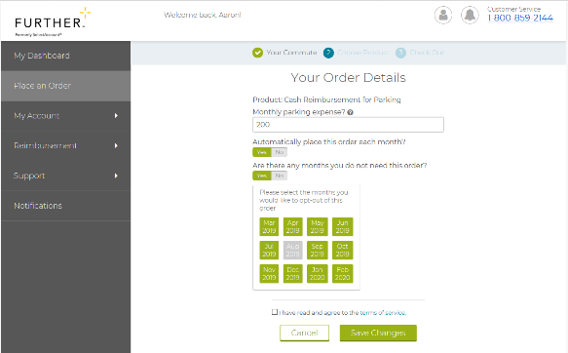
Placing an order (continued)
Complete the fields
Maximum order of $270 for transit and $270 for parking in 2021
If you exceed the maximum, you will be asked for a personal credit card when completing your order
You can set your order to recur monthly or to occur only in certain months

Slide 12
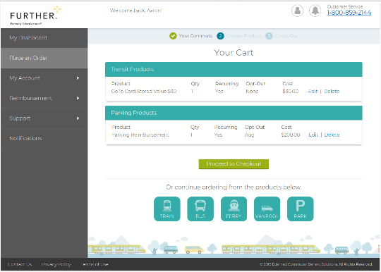
Order summary
Confirm your choices
Make another order or complete your purchase

Slide 13
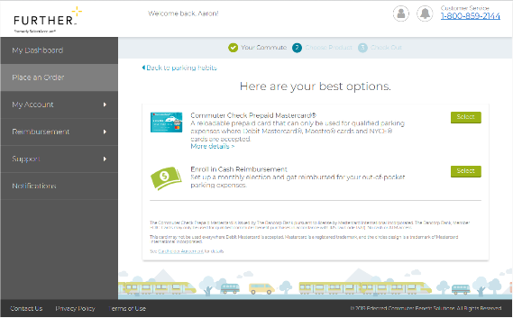
Parking
Allows you to choose cash reimbursement
After the benefit month begins, you must go back into the TRA dashboard and make a claim to receive the funds

Slide 14
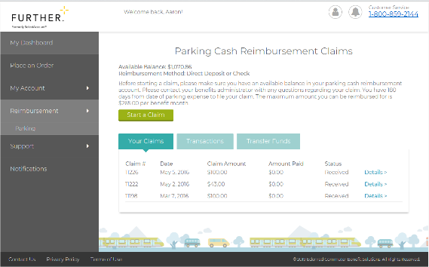
Parking – cash reimbursement
Confirm the amount you have set aside for parking
You may not claim more than $270 in any benefit month for parking
Complete the fields in the claim pop-up box
Retain receipts in case they are requested by the IRS

Slide 15
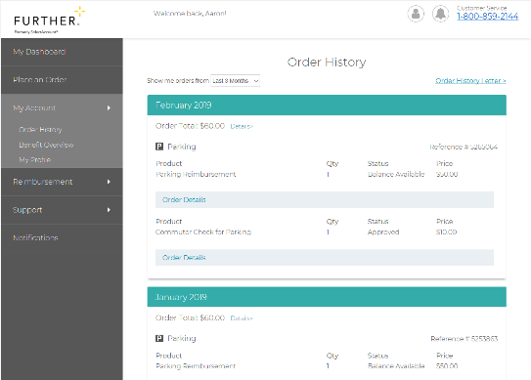
Commuting history
Some insurance companies provide a premium discount if you use public transportation frequently
Print your history to submit to insurance

Slide 16
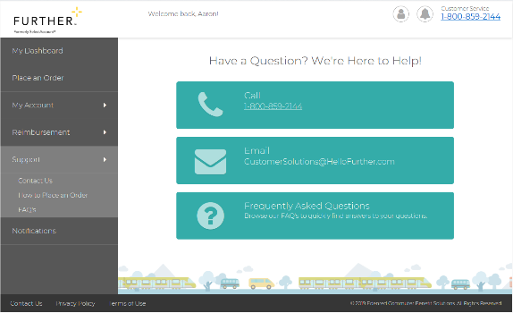
Help Tab
The help tab contains numerous resources and details regarding the parking and transit program and how to manage your dollars

Slide 17
Further TRA resources
An introduction to TRA: http://bit.ly/TRAintro
Placing an order for parking costs: http://bit.ly/ParkingOrder
Placing an order for transit costs: http://bit.ly/TransitOrder

Slide 18
TRA frequently asked questions
When is the monthly order deadline? 11:59pm EST on the 4th of the month prior to the benefit month. You can also set-up reoccurring orders. (Example: TRA orders for March must be placed by February 4th.)
Can I use TRA funds for both public transit and parking in the same month?
Yes. In 2021, you can contribute up to $270 for qualified parking and $270 for transit expenses each month ($540 combined monthly limit).
What happens to unused TRA funds? With an active TRA account, unused funds will continue to rollover every month and year as long as you stay enrolled in the benefit.
Can I use my TRA account for Uber or Lyft? Uber Pool and Lyft Line are qualified vanpool expenses when using your pre-paid TRA MasterCard. These are not available in all cities.
Can I order more than one TRA MasterCard?
No. Only one pre-paid MasterCard per TRA account. Once you order a TRA MasterCard, all parking, transit, and vanpool expenses must be done through that card.
What happens to my TRA dollars if I leave employment?
Dollars for cash parking or MasterCard remain available to use through the end of the last benefit month. After the end of the last benefit month these funds are returned to the employer. All other payment options will continue to be usable until the expiration stated on that option.

Slide 19
Let’s get started Our expert service team is ready to help.
800-859-2144
M-F 7 AM - 8 pm CST
hellofurther.com
Notes:
Adjust times to the appropriate time zone in which you are presenting

