Slide 1
Further
Spend every day wisely

Slide 2



Adoption Assistance Program (AAP)
2 | Proprietary + Confidential

Slide 3




Your Adoption Assistance Program (AAP) account
A personal expense account allowing you to pay for eligible adoption-related expenses with pretax dollars
Your contributions are pretax and deducted from your paycheck to fund the account
Save money on these costs¹
¹ ¹ Depends on your tax filing status. Please consult your tax advisor with questions.
3 | Proprietary + Confidential

Slide 4







How your AAP Works (like other spending accounts)
Enroll
in your company’s AAP Plan
Estimate
how much money you need to put toward adoption-related expenses
Plan Wisely any unused money will be forfeited at the end of the plan year
Select
how much money to withhold from each paycheck
Submit a Claim reimbursement form and receipts via fax, mail, secured email, or the Further portal*
Reimbursed you’ll be reimbursed up to the available balance in your account**
* A debit card is not available for this product
** Foreign adoption claim payments are limited to after the adoption is successful

Slide 5





You can use your AAP to pay for:
These you can’t pay for:
Agency and placement fees
Legal fees and court costs
Reasonable travel and lodging expenses related to the adoption
Medical expenses for the adoptive child prior to placement
Payments that aren’t related to the adoption of an eligible child as defined by the IRS
Expenses from a foreign adoption unless the adoption is successful*
Always save your receipts to ensure proper validation
of expenses, as required by the IRS.
* IRS rules for domestic and foreign adoptions differ. Consult with your financial advisor for details.

Slide 6


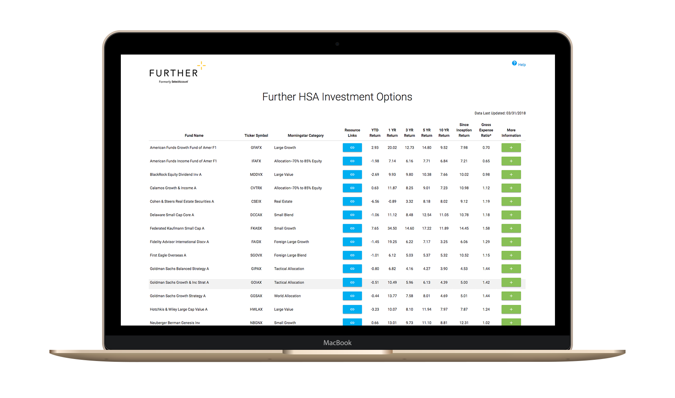
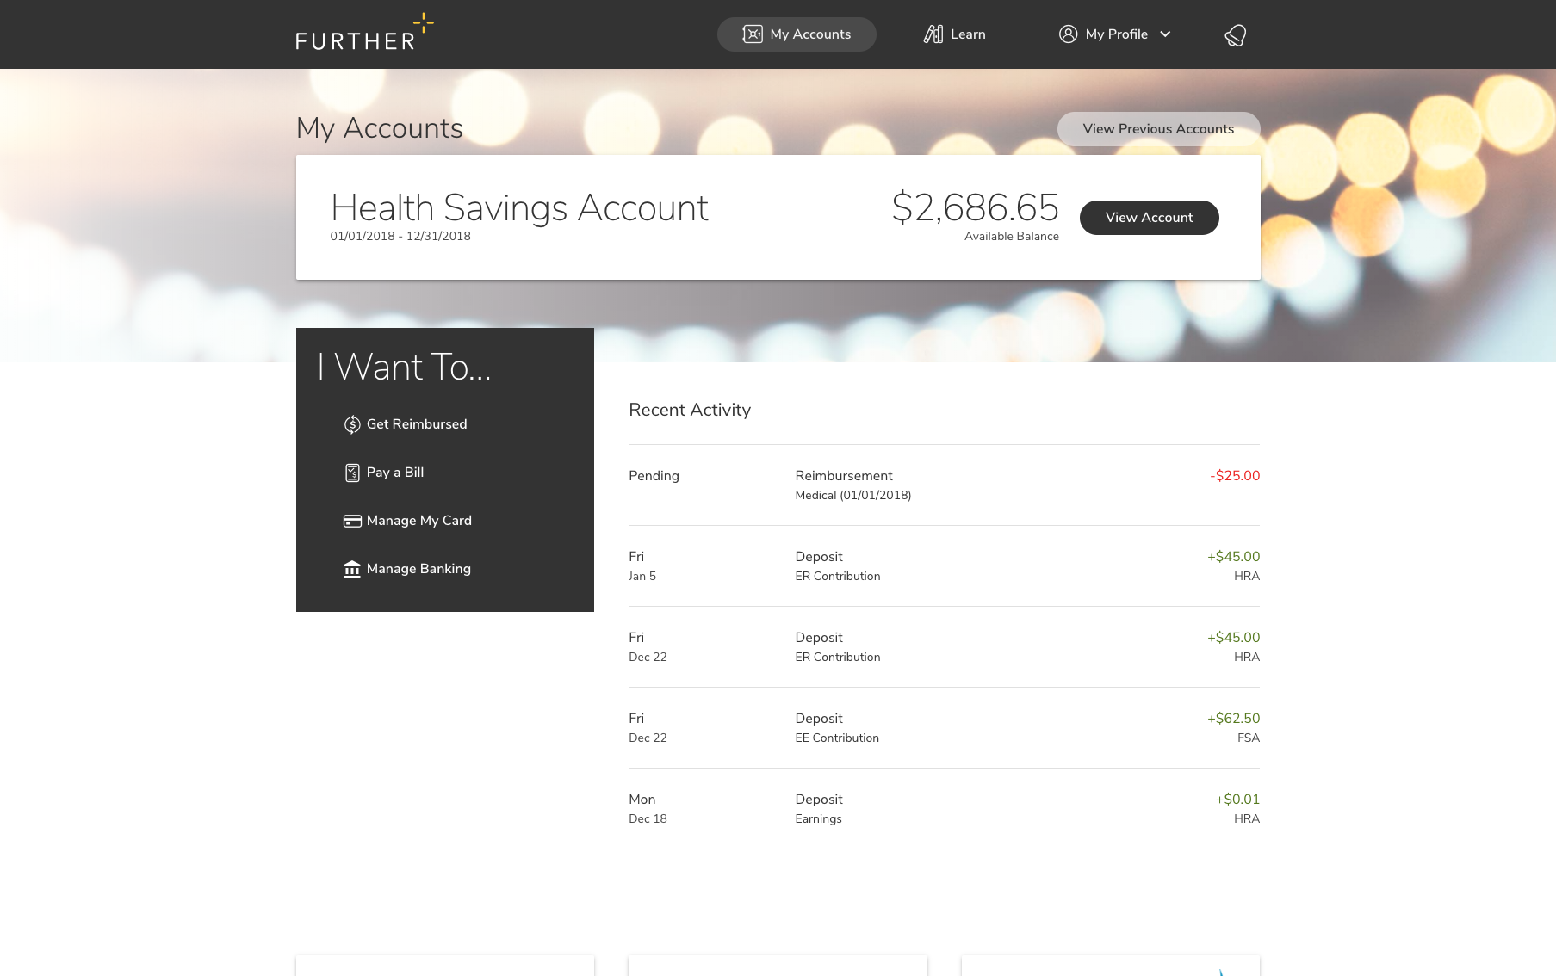
After you’re enrolled
Receive your Spending Account I.D. by mail
Register on hellofurther.com
Submit claims for reimbursement
View account activity and check balances
Download forms and upload receipts
Notes:
To be used for AAP

Slide 7


Let’s get started
Our expert service team is ready to help.
800-859-2144
M-F 7 AM - 8 pm CST
hellofurther.com
Notes:
Adjust times to the appropriate time zone in which you are presenting

