Slide 1
Further
Spend every day wisely

Slide 2
Health Savings Account
2 | Proprietary + Confidential

Slide 3
Your Health Savings Account (HSA)
Account you own that works with your HSA-qualified health plan
Allows you to set aside a portion of pretax payroll
You pay no taxes on the money you put into the account – or funds you take out to pay for qualified medical expenses
Any interest earned is tax-free
No “use it or lose it” stipulation; unused funds rollover to the next year
The account stays with you, even if you change jobs or retire
3 | Proprietary + Confidential

Slide 4
The advantage of an HSA
With the triple tax advantage, an HSA allows you to see significant tax benefits
Contribute
Spend
Earn interest
Your contributions are taken from your paycheck before they’re taxed, so it reduces your taxable income
You can make tax-free withdrawals for qualified medical expenses any time
Any interest, dividends or capital gains your account earns are tax-free

Slide 5
More of your money stays with you – now and for the future
The advantage of an HSA
Lower premiums You keep more dollars in your pocket each paycheck
You own the account If you change jobs or retire, the HSA and funds go with you
Rollover remaining funds Help you build savings for retirement or a large medical expense
Average Annual Premium Cost¹
Savings
with an HSA
PPO
HSA
Employee
$1,335
$1,061
$274
Family Plan
$6,017
$4,852
$1,165
¹ Kaiser Family Foundation. 2020 Employer Health Benefits Survey; Summary of Findings. Oct 08 2020. https://www.kff.org/health-costs/report/2020-employer-health-benefits-survey/.

Slide 6
Your health care is the right size - for you
The advantage of an HSA
Most people in traditional health care plans never spend their deductible over the year
The majority are over-insuring themselves for health care and over-spending crucial dollars that could be used on other things
Choosing the wrong plan can be costly¹
Example: 2,300 employee company
97%
of employees
would have been better off with a lower premium plan but higher cost-sharing
23%
chose the
higher-premium
plan anyway
$2,000+
Average cost per year
of choosing the wrong plan
¹ Collier T, Williams M L. Picking the wrong health insurance is a $2,000 mistake. Marketwatch, The Conversation. Nov 10, 2020. https://www.marketwatch.com/story/picking-the-wrong-health-insurance-is-a-2-000-mistake-11605021943.

Slide 7
How your HSA works
Enroll in your company’s HSA-qualified health plan
Ensure
that you:
Set aside
portion of payroll pretax, not more than:
2021:
$3,600 for single
$7,200 for family
2022:
$3,650 for single
$7,300 for family
Use
a convenient
Further debit card to
pay providers
Submit bills
for reimbursement of
out-of-pocket expenses
Are not claimed as a dependent on someone else’s tax return
Have no other health plan coverage (including spouse’s medical FSA¹)
Are not enrolled in Medicare
¹ HSA can be combined with FSA only if FSA is limited to dental and/or vision coverage.

Slide 8
You can use your HSA to pay for:
These you can’t pay for:
NEW! Over-the-counter supplies, medications, and some feminine hygiene products
Medical expenses not covered by your health plan, including:
Health insurance premiums
COBRA during a job transition or post-employment
Medicare upon reaching the age of 65
Some long-term care insurance premiums
Expenses that aren’t related to medical treatment or care as defined by the IRS
Personal use items
Toothpaste
Lotions
Makeup
Soaps
Shaving supplies
Health insurance premiums
Out-of-pocket expenses
Co-pays
Co-insurance
Prescription drugs
Dental care expenses
Vision care expenses
It’s important to save all your receipts to validate expenses, as required by the IRS.
Notes:
*Medical expenses that can be reimbursed through your medical spending account include services and supplies incurred by you or your eligible dependents for the diagnosis, treatment or prevention of disease or for the amounts you pay for transportation to get medical care. In general, deductions allowed for medical expenses on your federal income tax according to Internal Revenue Code Section 213 (d) may be reimbursed through your HSA. You cannot deduct medical expenses on your federal income tax that have been reimbursed through your HSA. It is possible that changes in the IRS rules can affect the eligible, potentially eligible, and/or ineligible expense categories.

Slide 9
Meet Molly Single professional, no children
 | Without an HSA | With an HSA
Estimated taxes¹ | $14,400 | $13,500
Health care expense | $600 | $600
HSA account | $0 | $3000
HSA balance to rollover | $0 | $2,400
$900 Tax Savings
Annual salary: | $48,000
HSA contribution: | $3,000
Taxable income: | $45,000
At year’s end, Molly has not only saved $900 in taxes, but has used those savings to cover all her health care expenses AND established an HSA account that is available for future expenses.
¹Assumes Molly is subject to a 30% income tax rate. Actual tax savings will depend on your HSA contributions, applicable state tax rates and your personal tax situation. Please consult your tax adviser for details.
Molly’s story is a hypothetical example for purposes of illustration only.
9 | Proprietary + Confidential

Slide 10
 | Without an HSA | With an HSA
Estimated taxes¹ | $20,400 | $18,900
Health care expense | $2,500 | $2,500
HSA account | $0 | $5,000
HSA balance rollover | $0 | $2,500
$1,500 Tax Savings
Meet the Garcias Maria and her teenage son, Antonio
At year’s end, Maria has not only saved $1,500 in taxes, but has used those savings to cover approximately half of her health care expenses. She has also established an HSA account that is available for future expenses.
Annual salary: | $68,000
HSA contribution: | $5,000
Taxable income: | $63,000
¹Assumes the Garcias are subject to a 30% income tax rate. Actual tax savings will depend on your HSA contributions, applicable state tax rates and your personal tax situation. Please consult your tax adviser for details.
The Garcia’s story is a hypothetical example for purposes of illustration only.
10 | Proprietary + Confidential
Notes:
Meet the Martinez Family
Maria is 41 and a manager at a small manufacturing business earning $68,000 per year. Her son, Antonio, is very involved in sports at his middle school. As a single parent, Maria is always looking for ways to save on health care costs and be ready for any unexpected costs that may not be covered by their health plan. As a way to curb rising health care premiums her employer only offers plans with high deductibles. Maria sees an HSA as a flexible way to help her manage their health care costs and save for medical expenses as Antonio enters high school.
Income $68,000
HSA Contribution $5,000 (pretax contribution)
Net Taxable Income $63,000
Tax @ 30% $18,900 (vs. $20,400 on $68K)
Tax Savings $1,500
Medical expense $2,500 (paid out of the HSA)
HSA Balance $2,500 (always carries over year after year)

Slide 11
Meet the Robinsons Two-parent family with two school-age children
 | Without an HSA | With an HSA
Estimated taxes¹ | $28,260 | $26,100
Health care expense | $1,800 | $1,800
HSA account | $0 | $7,200
HSA balance rollover | $0 | $5,400
Combined annual salary: | $94,200
HSA pretax contribution (2021 limit): | $7,200
Net taxable income: | $87,000
$2,160 Tax Savings
At year’s end, the Robinsons have not only saved $2,160 in taxes, but they have used those savings to cover all their health care expenses AND established an HSA account that is available for future expenses.
¹Assumes the Robinsons are subject to a 30% income tax rate. Actual tax savings will depend on your HSA contributions, applicable state tax rates and your personal tax situation. Please consult your tax adviser for details. The Robinson’s story is a hypothetical example for purposes of illustration only.
11 | Proprietary + Confidential
Notes:
Meet the Robinsons.
Isiah and Michelle have a growing family with two school-age children. Isiah works for a large manufacturing company as a manager making $56,000. Michelle runs her own catering business from home and makes $38,200. Isiah’s employer offered an HSA-qualified health plan this year that allows him to set aside up to $7.200 tax-free to pay for annual deductibles, save for dental and vision expenses and be prepared for any unplanned medical costs that may come up. The Robinsons decide to contribute $7.200 because they know any amount contributed and any interest it may earn is tax-free and remains theirs from year-to-year for qualified expenses. And, because their balance is above $1,000, they take advantage of the more than 30 investment options available through Charles Schwab, anticipating their balance will increase each year.
Income $94,200
HSA Contribution $7,200 (pretax contribution – the max for 2021)
Net Taxable Income $87,000
Tax @ 30% $26,100 (vs. $28,260 on $94,200)
Tax Savings $2,160
Medical expenses $1,800 (paid out of the HSA)
HSA Balance $5,400

Slide 12
Meet the Schwartz Family Empty nesters – Bill and Emily, retiring in five years
Combined annual salary: | $125,000
HSA pretax contribution (2021 limit)*: | $8,200
Net taxable income: | $116,800
 | Without an HSA | With an HSA
Estimated taxes¹ | $37,500 | $35,040
Health care expense | $1,400 | $1,400
HSA account | $0 | $8,200
HSA balance rollover | $0 | $6,800
$2,460 Tax Savings
*includes $1,000 extra contribution
At year’s end, the Schwartzs have not only saved $2,460 in taxes, but they have used those savings to cover all of their health care expenses AND continued to contribute to an HSA account that is available for future expenses.
¹ Assumes the Schwartzs are subject to a 30% income tax rate. Actual tax savings will depend on your HSA contributions, applicable state tax rates and your personal tax situation. Please consult your tax adviser for details. ² Balances over $1,000 are eligible to invest in more than 30 mutual fund options through Charles Schwab.
The Schwartz’s story is a hypothetical example for purposes of illustration only.
12 | Proprietary + Confidential
Notes:
Meet the Schwartz Family.
Bill and Emily Schwartz are 58 and healthy empty nesters. With their children on their own, Bill is looking ahead to retiring from his corporate job in five years where he earns a salary of $98,000. Emily is a freelance web designer whose services are increasingly in demand. She made $27,000 just starting out, with increased opportunities to double that next year. They want to maximize their retirement savings by taking advantage of the extra contribution available for people 55 years and older. That way they can plan for medical expenses that may not be covered once they are on Medicare.
Income $125,000
HSA Contribution $ 7,200 (pretax contribution)
Extra contribution $ 1,000 (pretax contribution) Note: *Includes $1,000 catch up contribution for people 55 years of age and older.
Net Taxable Income $116,800
Tax @ 30% $ 35,040 (vs. $37,500 on $125,000)
Tax Savings $2,460
Medical expenses $1,400 (paid out in medical expenses)
HSA Balance $6,800 carries over to next year and can be invested

Slide 13
Combine HSA
Pairing with an FSA
If paired with an FSA, the FSA will be limited to permitted benefits such as vision and dental care benefits until the health plan deductible is met.
Pairing an HSA with an FSA and/or VEBA increases the spending and savings power for members
Pairing with a VEBA
If paired with a VEBA, the VEBA will be limited to permitted benefits such as vision and dental care benefits until the health plan deductible is met.
Pairing with an FSA and VEBA
Combining the benefits of the HSA, FSA, and VEBA allows members to maximize tax-advantaged medical spending and savings.

Slide 14
Shop for care
HSA strategy:
Use the preventive care portion of your plan
Use MinuteClinic® or retail clinics
Go online for doctor visits
Choose generic drugs
Inform your doctor/provider that you are enrolled in a CDHP (consumer-directed health plan)
Shop for medical value – compare charges
Evaluate different pharmacies and look up manufacturer discounts on prescriptions
Access the Amazon® FSA/HSA store to shop by category, price, and best sellers
Use your health plan tools and resources
14 | Proprietary + Confidential

Slide 15
Delay reimbursements and save receipts
HSA strategy:
Opt out of the crossover feature
Any expense you incur after you’ve established your HSA and pay out-of-pocket expenses creates an opportunity for a tax-free withdrawal
Your ability to submit claims never expires as long as you have a balance in your HSA
You retain a higher HSA balance to earn interest or invest, increasing the potential for growth
You can stop and continue this strategy as you see fit, or as major life events occur – such as an interruption or reduction to income
At age 65, you can make distributions from your HSA for non-eligible expenses without a penalty; just pay your income taxes
15 | Proprietary + Confidential

Slide 16
5 ways an HSA can help you save for your future
Money is not taxed Money goes into your HSA without paying state* or federal taxes. That reduces your taxable income and saves you money on your medical expenses.
No “use it or lose it” rule Money in your HSA belongs to you, even if you change jobs, health plans, or retire
Invest and grow your money Your money can earn interest, tax-free, from day one. When your Base Balance reaches $1,000, you can open a basic investment account with access to invest in over 30 mutual funds
More flexibility and choice You can use your HSA dollars for certain health care expenses that aren’t covered by your health plan, allowing you to purchase these services tax-free
Even out medical expense highs and lows Since you manage your funds, you can choose to save HSA money when you’re healthy so it’s ready when you need it
16 | Proprietary + Confidential
* Tax laws vary by state. Please consult your tax advisor with questions.

Slide 17
Investment options
Up to $10,000
Basic Investment account
$10,000+
Self-directed brokerage account
$1,000
Base Balance
After minimum Base Balance is met, employee is invited to
access a Basic Investment lineup of 30+ mutual funds
When Basic Investment account assets exceed $10,000, employee can choose to invest funds with a self-directed brokerage account
Employee maintains
$1,000 balance in HSA

Slide 18
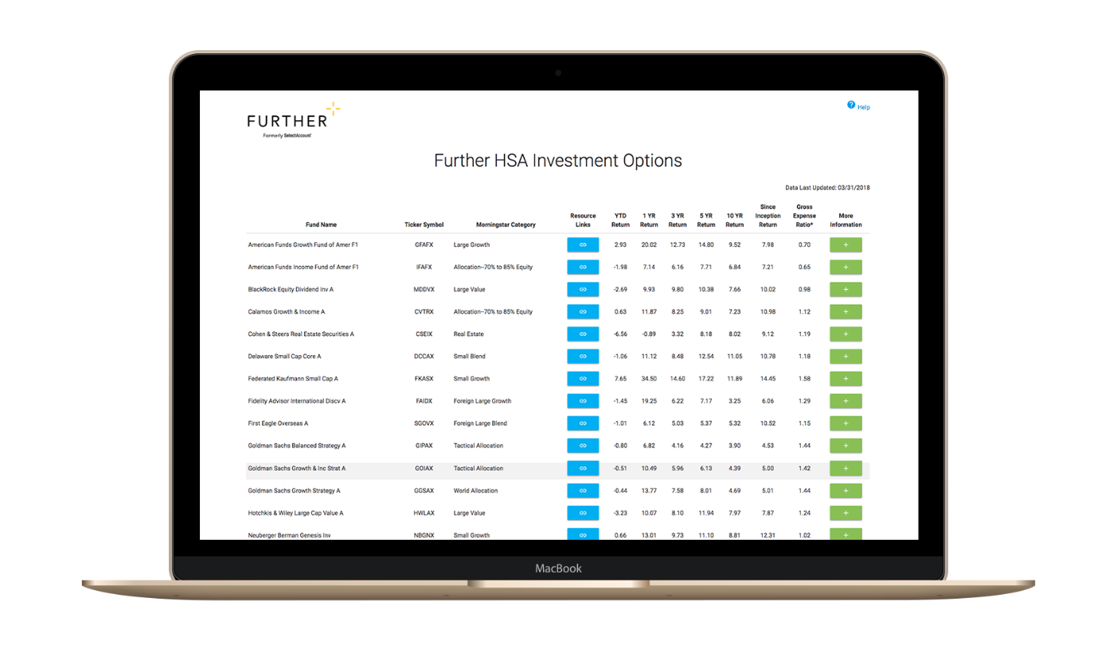
More than 30 mutual funds offered
Notes:
https://hsainvestments.com/fundperformance/?p=HCF

Slide 19
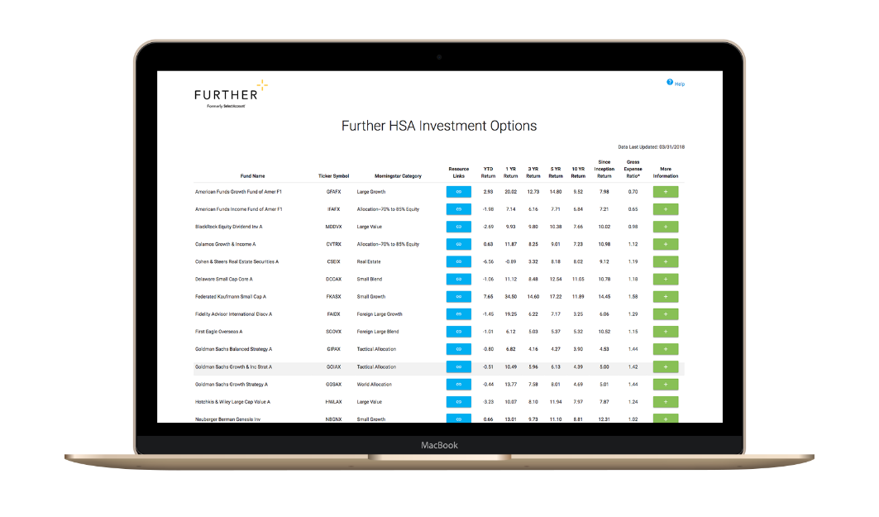
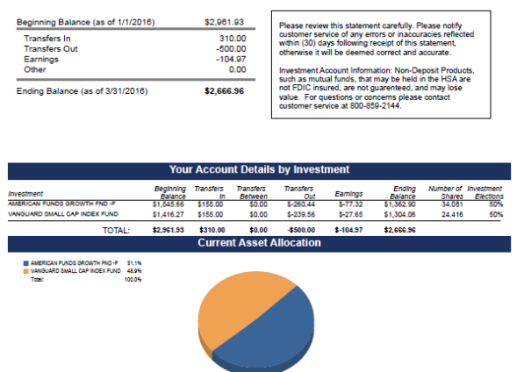
Quarterly investment statements
Review activity
Manage asset allocation
View fund performance

Slide 20
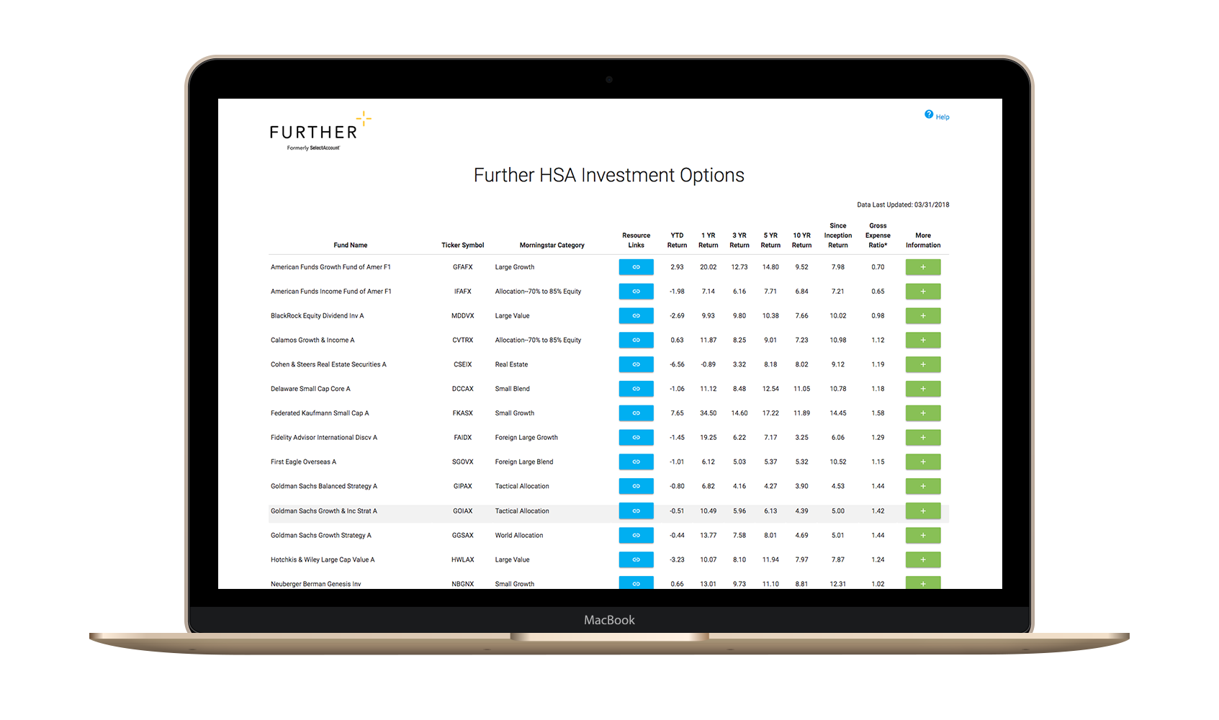
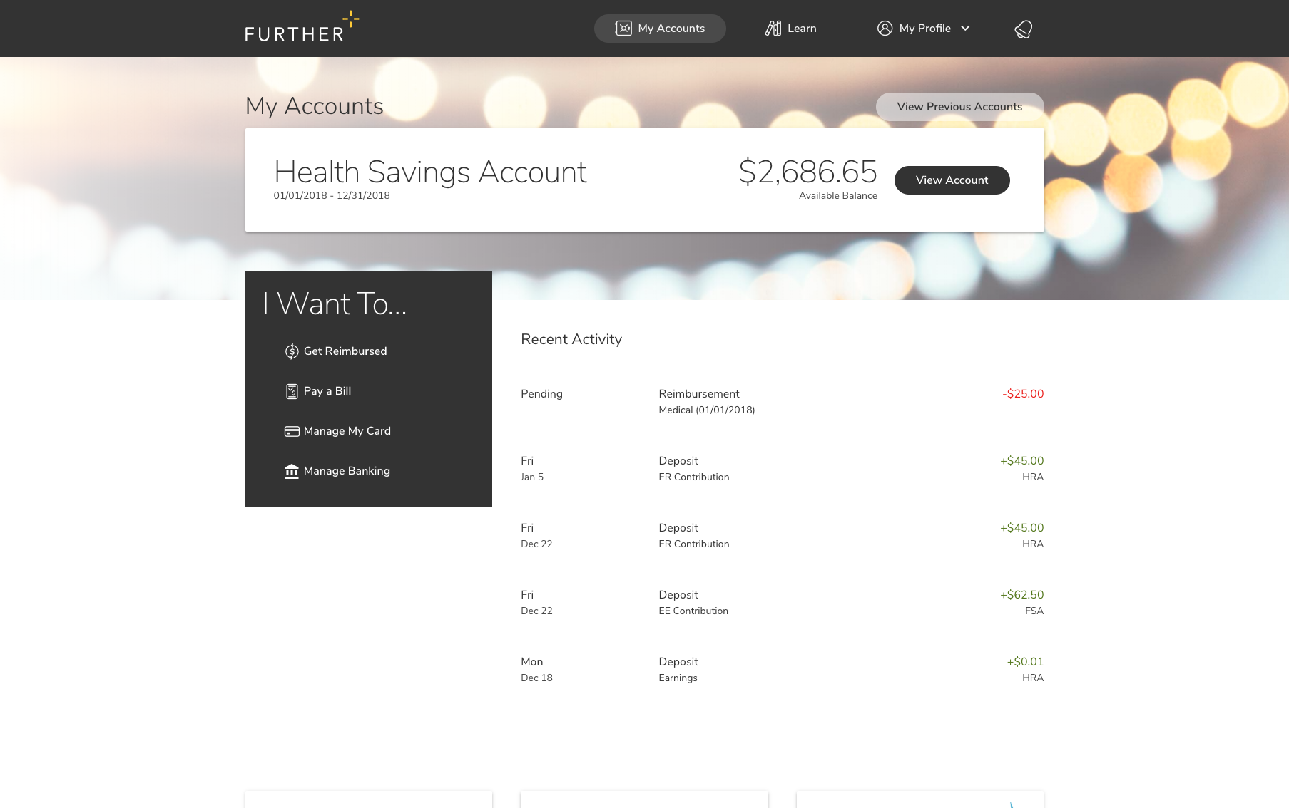
After you’re enrolled
Receive your Spending Account I.D. and Visa® debit card by mail
Register on hellofurther.com
Download mobile app
Pay providers with your Visa® debit card or submit claims for reimbursement
View account activity and check balances
Download forms and upload receipts
View and manage investments over $1,000
Request additional Visa® debit cards
Notes:
To be used for HSA

Slide 21
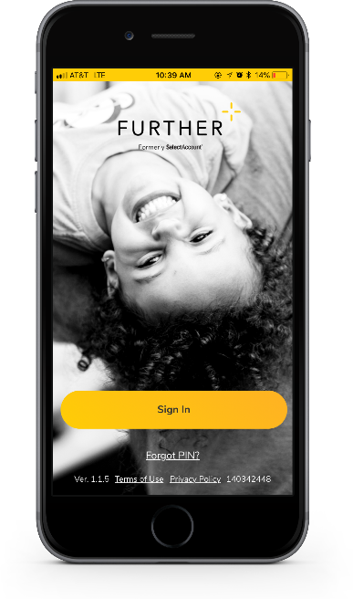
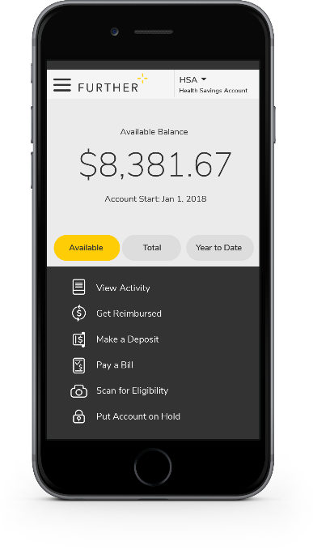
Mobile App
Easy to use tool that features:
Fingerprint and facial ID unlock
Snap and save document photos
Barcode scanner to check eligibility
Mobile access to all primary actions
View activity
Pay bills
Make deposits
Get reimbursed
Text options for account activities

Slide 22
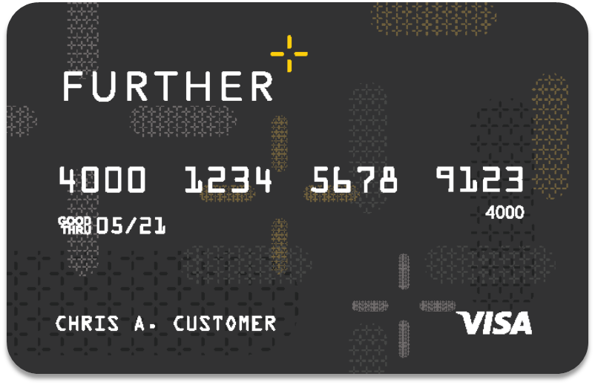
Further debit card
Can use for HSA, FSA, HRA and VEBA purchases
A convenient way to pay for qualified purchases from your spending account(s)
Can be added to your digital wallet¹
Can order additional cards for spouse or dependent free of cost
Accepted anywhere VISA® is accepted
The debit card will come in a plain envelope – do not throw it away.
¹Digital payments not available on all accounts.

Slide 23
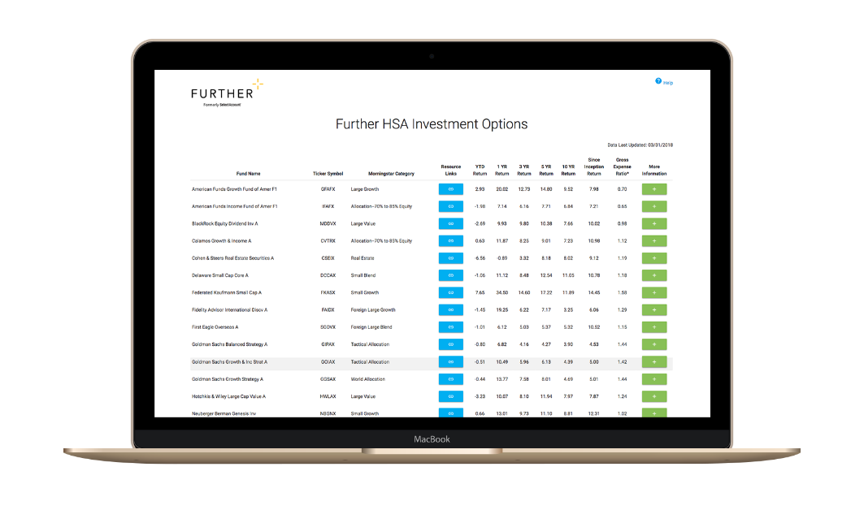
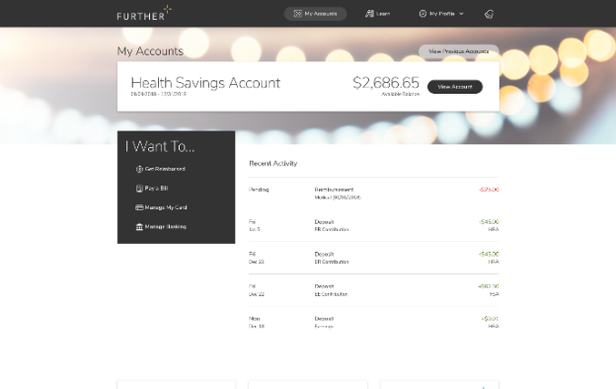
Learning Center
The Learning Center offers a robust array of articles, tools, and resources including:
Savings calculators, videos and popular forms
Guidance to help compare products
Employer walkthrough of open-enrollment communication
Tips for submitting claims
Help using and managing your account
Tax implication information
How to get reimbursed
FAQs
Designed to help you understand and maximize your health savings accounts

Slide 24
Let’s get started Our expert service team is ready to help.
800-859-2144
M-F 7 AM - 8 pm CST
hellofurther.com
Notes:
Adjust times to the appropriate time zone in which you are presenting

